Slide 1

Drugio
A Pharmaceutical Information System
Paboda J. M. S
215085N
Supervisors
Dr. R.L.C. Shyama
Mr. Deshan Chathuranga
Notes:
Slide 1 – Background
“Good day everyone, I’m Savindi Paboda, and today I will be presenting my project Drugio.

Slide 2
Background
Drugio is a mobile application designed to provide comprehensive drug information and facilitate communication between users and pharmacies. Many users face difficulties in finding accurate medication details and checking drug availability efficiently. Traditional methods like physical visits are time-consuming, so Drugio offers a digital solution that enhances accessibility and convenience. The app enables users to search for drugs, retrieve detailed information, upload prescriptions to get pharmacist responses and send WhatsApp inquiries to pharmacies.
2
Notes:
Drugio is a mobile application designed to provide comprehensive drug information and to facilitate communication between users and pharmacies.
The idea came from a common problem many users in Sri Lanka face — difficulties in finding accurate medication details or checking drug availability quickly. Traditional methods, such as physically visiting pharmacies or relying on posts we see on social media, are time-consuming and unreliable.
Drugio solves this problem by offering a digital solution that improves accessibility and convenience. Through the app, users can search for medicines, view detailed information, upload prescriptions to get pharmacist responses, and even send WhatsApp inquiries to pharmacies directly.”

Slide 3
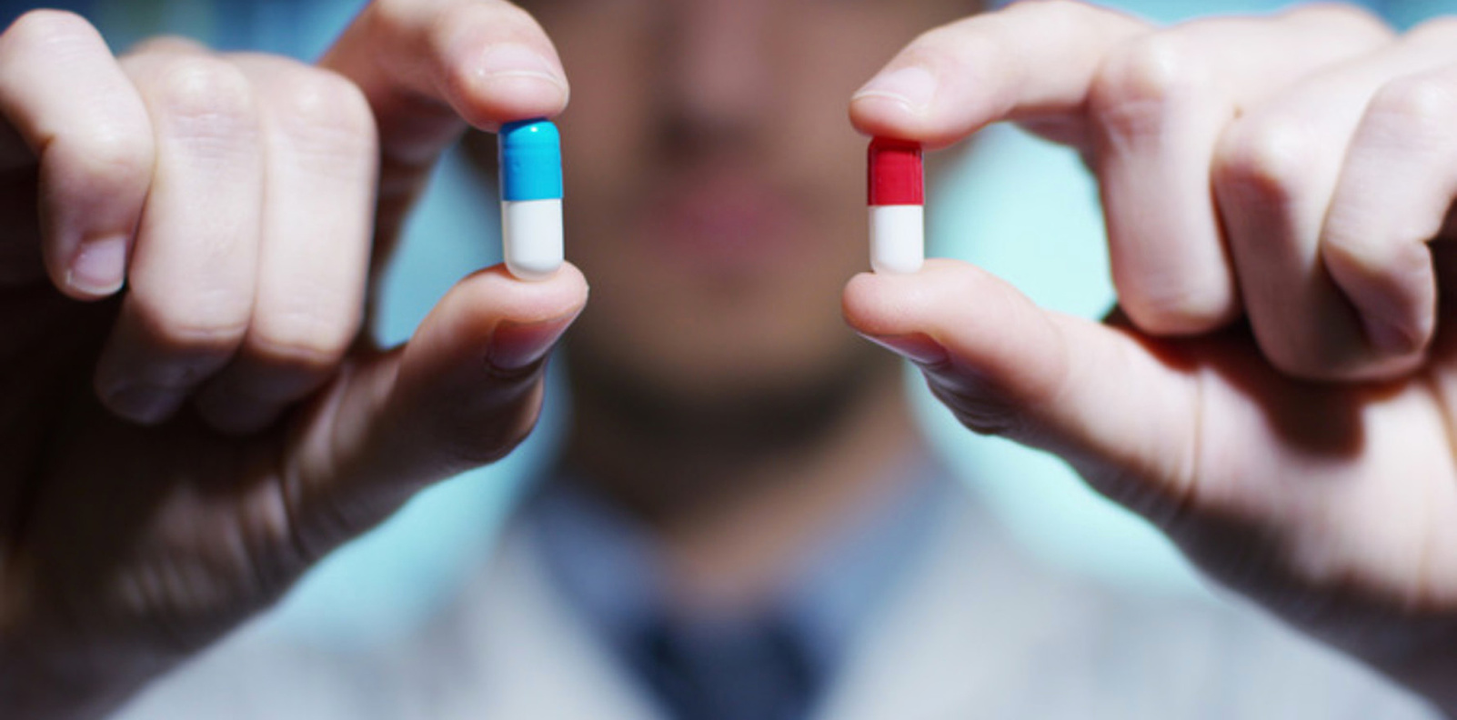
Problem In Brief
Healthcare professionals and users often rely on outdated or scattered resources to access drug information.
Difficulty in quickly searching drug names, dosages, and brand–generic relationships.
No centralized, user-friendly way to connect with nearby pharmacies.
Time-consuming process of physically visiting or calling pharmacies to check medication availability.
No proper digital platform for prescription review and pharmacist feedback.
These issues lead to delays, inefficiencies, and potential health risks in critical situations.
3
Notes:
Slide 2 – Problem in Brief
“The problem can be summarized into a few key points:
First, both healthcare professionals and the public often rely on outdated or scattered resources to access drug information.
Second, there is difficulty in quickly searching for drug names, dosages, and brand–generic relationships.
Third, there is no centralized, user-friendly platform to connect with nearby pharmacies.
As a result, people waste time physically visiting or calling pharmacies just to check availability.
And finally, there is no proper digital platform for handling prescription reviews and pharmacist feedback.
Altogether, these issues lead to delays, inefficiencies, and potential health risks in critical situations.”

Slide 4
Aim & Objectives
The Aim is to develop a mobile application for general users and pharmacists, along with a web application for administrators, that provides real-time drug information, simplifies pharmacy communication, and enables prescription handling with digital efficiency.
Objective 01
Objective 02
Objective 03
Provide accurate, up-to-date drug information, improving their ability to deliver quality patient care.
Offering a digital platform that reduces errors and delays in identifying and managing medications.
Allow users to upload prescriptions and enable pharmacists to respond with suggestions digitally..
Objective 04
Objective 05
Enabling real-time communication between users and pharmacies or distributors, ensuring timely access to medications.
Offer valuable insights and analytics on drug usage trends and availability, supporting informed decision-making for healthcare professionals and pharmaceutical businesses.
4
Notes:
Slide 3 – Aim & Objectives
“The aim of my project is to develop a mobile application for general users and pharmacists, along with a web application for administrators.
This system provides real-time drug information, simplifies pharmacy communication, and enables prescription handling in a digital and efficient way.
The main objectives are:
To provide accurate and up-to-date drug information.
To reduce errors and delays in identifying and managing medications.
To allow users to upload prescriptions and receive pharmacist responses digitally.
To enable real-time communication between users and pharmacies, ensuring timely access to medicines.
And finally, to provide insights and analytics on drug usage trends, supporting better decision-making for healthcare professionals and pharmaceutical businesses.”

Slide 5
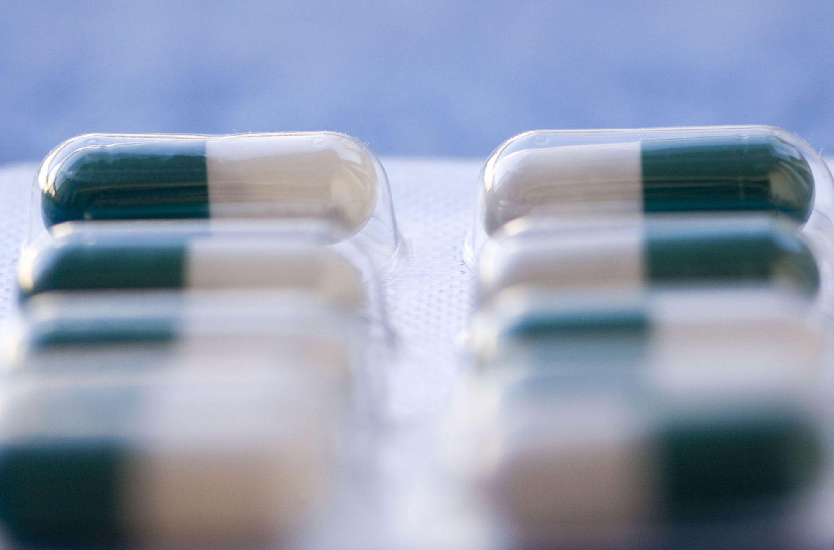
Proposed Solution
Drugio provides real-time drug information and availability, helping users search for medications and check availability in nearby pharmacies.
Inputs
Process
Outputs
Dashboard with monitoring insights.
Display comprehensive details about the drug, including its brand, strength,
dosage form, manufacture details, local distributor details.
Drug availability in nearby pharmacies.
Notifications and alerts
Enter either generic or brand names, retrieving related information.
Check drug availability by sending a message via WhatsApp to pharmacies in a specific area.
Upload printed or handwritten prescriptions.
Admins log in using a username and password for profile access.
User Search and Information Retrieval
Pharmacy Selection and Availability Check
Notify pharmacists of new prescription uploads; pharmacists review and submit medicine suggestions.
Admin Management - Add, Update and Delete drug, pharmacy information & monitor prescription uploads
Users
Generic User - Pharmacists, Pharmaceutical Students, Pharmaceutical Representatives, General Public and Patients
Administrator
5
Notes:
“The proposed solution consists of two main parts: the mobile application and the web application.
On the mobile side, users can search for medicines either by brand name or by generic name. If a brand is selected, the app shows all the related details. If a generic is selected, the app lists all brand names available under it.
Users can also find nearby pharmacies using their device location and contact them directly through phone, SMS, or WhatsApp.
In addition, users can upload prescriptions with comments. Pharmacists receive notifications, review the prescription, and respond with medicine suggestions, which are then displayed to the user in the app.
On the web side, administrators can log in to manage medicines and pharmacy records, monitor prescription uploads, and view insights through a dashboard.
So overall, Drugio creates a complete ecosystem that connects users, pharmacists, and administrators on one digital platform.”

Slide 6
System Demonstration
6
Notes:
now let's move on to the system demonstration.

Slide 7





Flutter (Cross platform development - Mobile App)
Reactjs (Web App - Frontend
Development)
Technologies
Nodejs (Backend development)
MySQL (Database)
Firebase (User Authentication, storage and notifications)
7

Slide 8
UI Design
6

Slide 9
Further Work
Complete the Implementation of Core Features
Enhance the Admin Panel
Testing and Debugging
Security and Compliance Enhancements
Deployment and Hosting
8

Slide 10
Work Breakdown Structure
Phase 01
Phase 02
Phase 03
Phase 04
Research & Planning
System Design
Development
Testing and Deployment
Requirement gathering
Literature review
Feasibility analysis
UI/UX design
Database schema design
Backend development
Web app development
Mobile app development
Unit testing
Integration testing
Final deployment
9

Slide 11
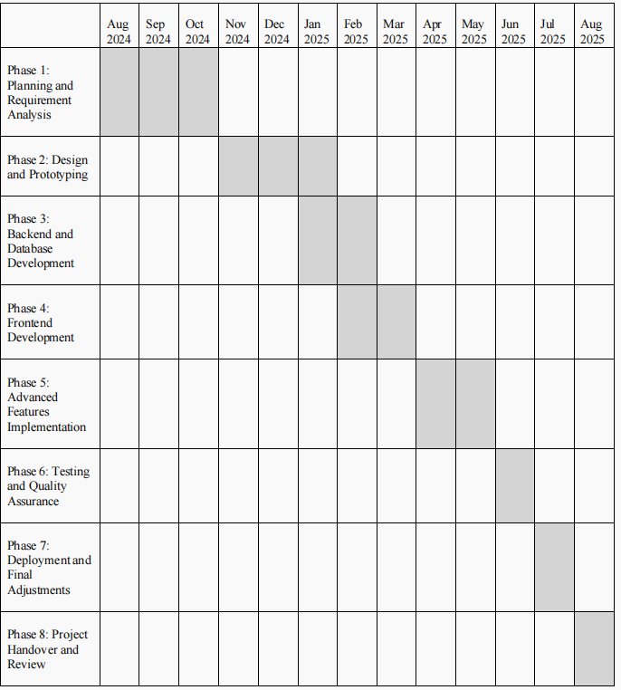
Timeline
10

Slide 12

THANK YOU!

